Slide 1

Track module 1 Basics of Machine Learning in Python Block 4
Ekaterina Golubeva
31.10.2022

Slide 2
Plan
What is Machine Learning?
Splitting data into training and testing sets
What are features in Machine Learning?
How to generate features?
What are Gabor filters?

Slide 3
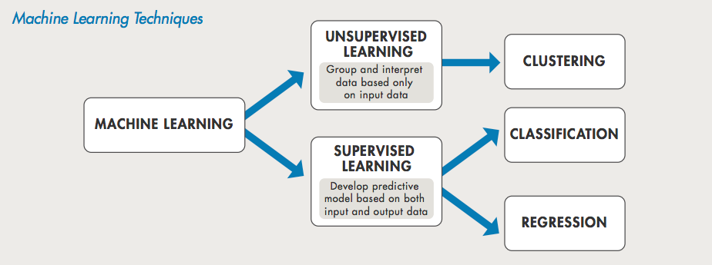
What is Machine Learning ?

Slide 5
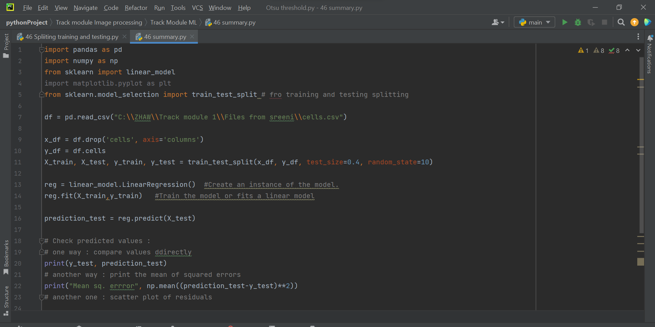
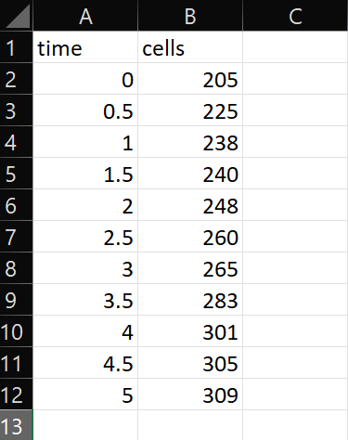
Splitting data into training and testing sets

Slide 6
What are features in Machine Learning?
Feature is a characteristic that describe our data. Is used in supervised ML.
Examples : results of different filters like edges enhancement, local contrast, entropy, blurring filters etc.
What is a feature vector ?
How do we know which filters work ?
Which ML should you use ?

Slide 8
Performance of ML algorithms

Slide 9
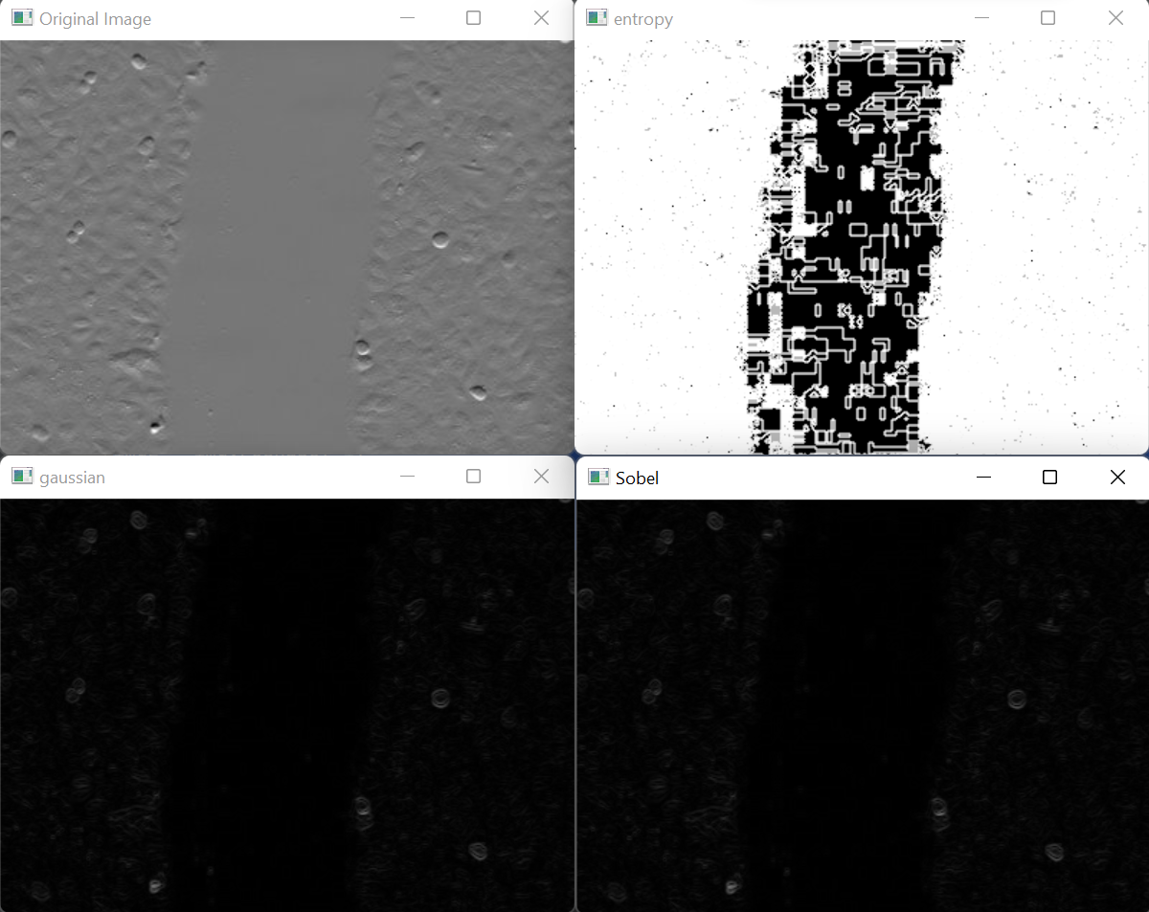
How to generate features in Python for ML ?

Slide 10
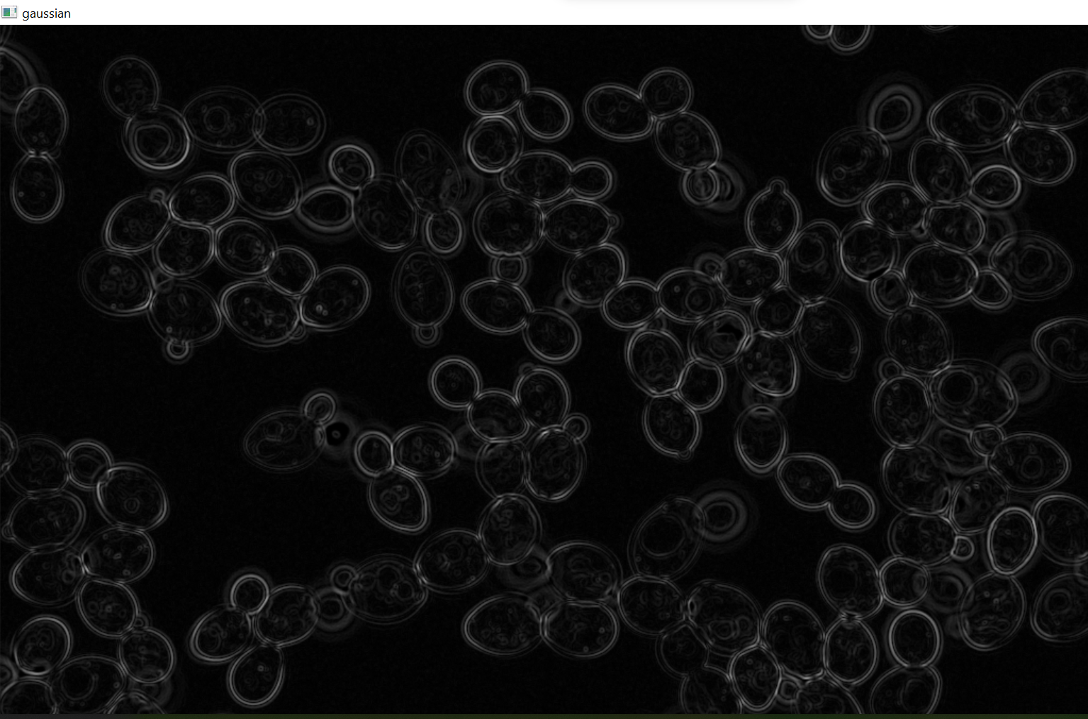
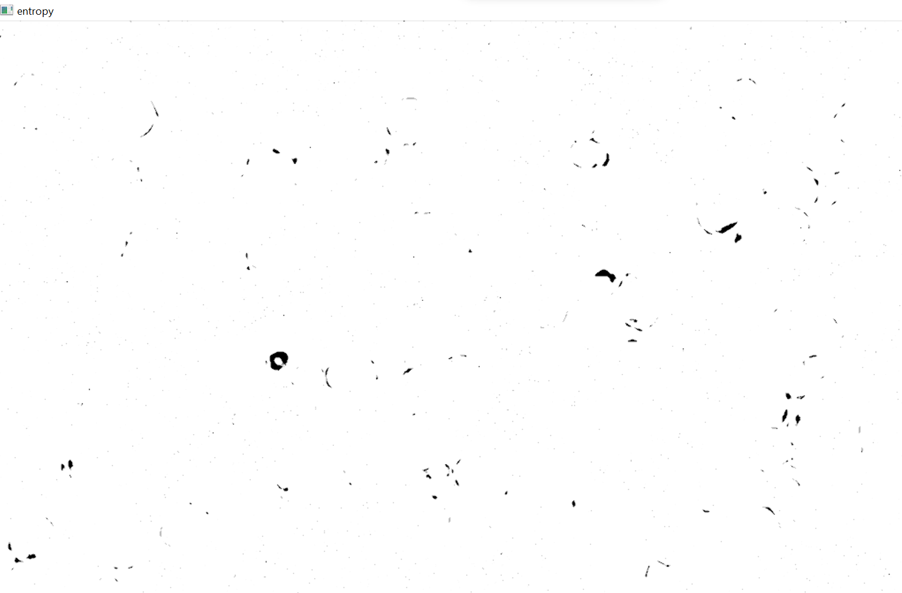
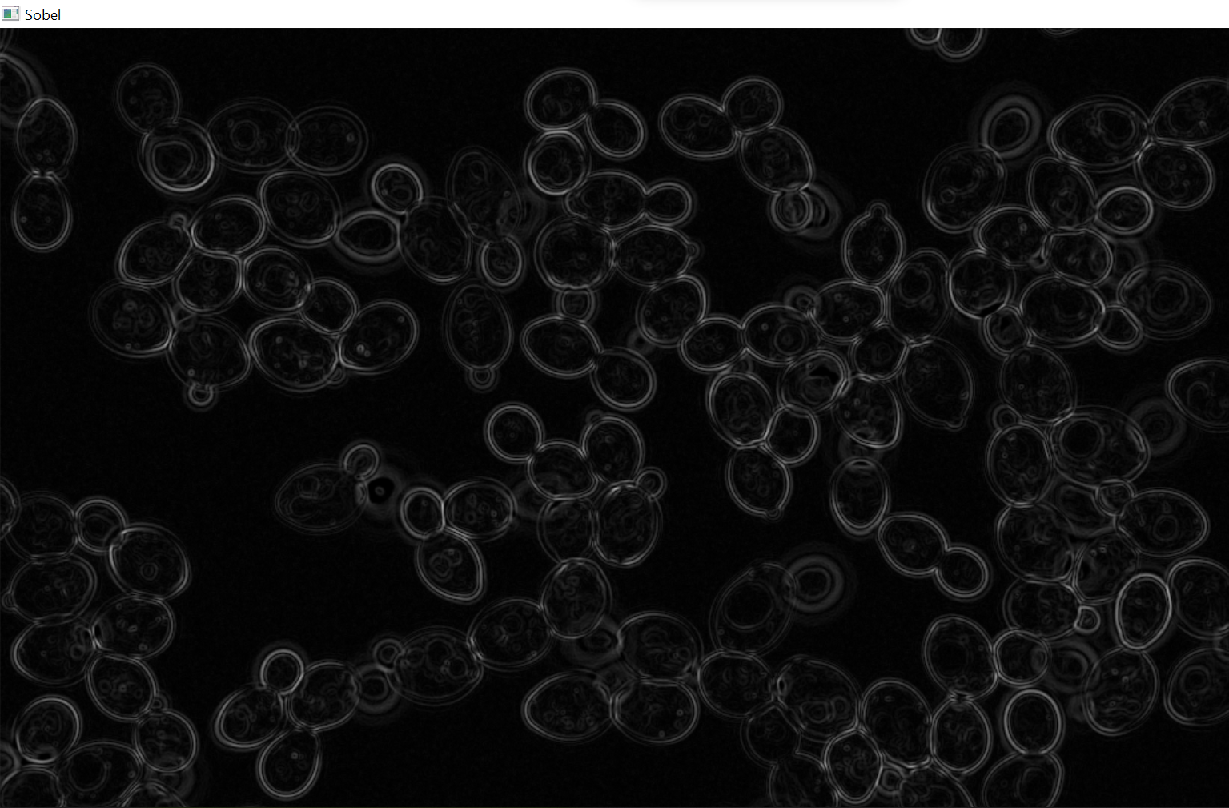
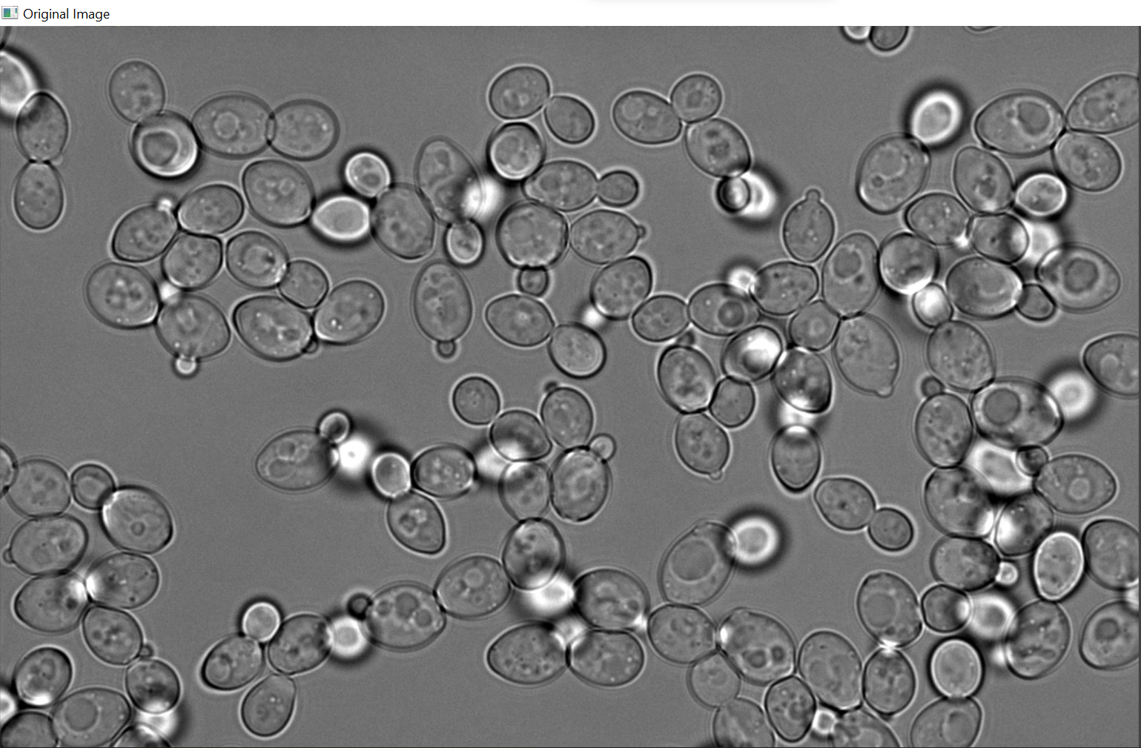

Slide 11
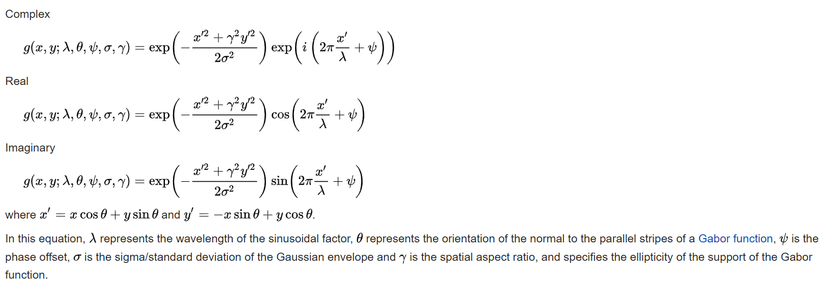
What are Gabor filters?
For image processing and computer vision, Gabor filters are generally used in texture analysis, edge detection, feature extraction, etc.
Gabor filters are special classes of bandpass filters, i.e., they allow a certain ‘band’ of frequencies and reject the others.

Slide 12
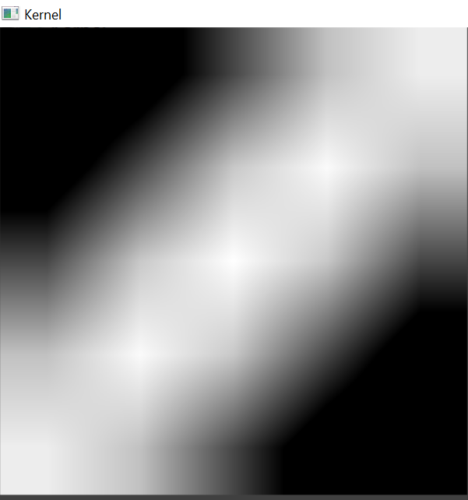


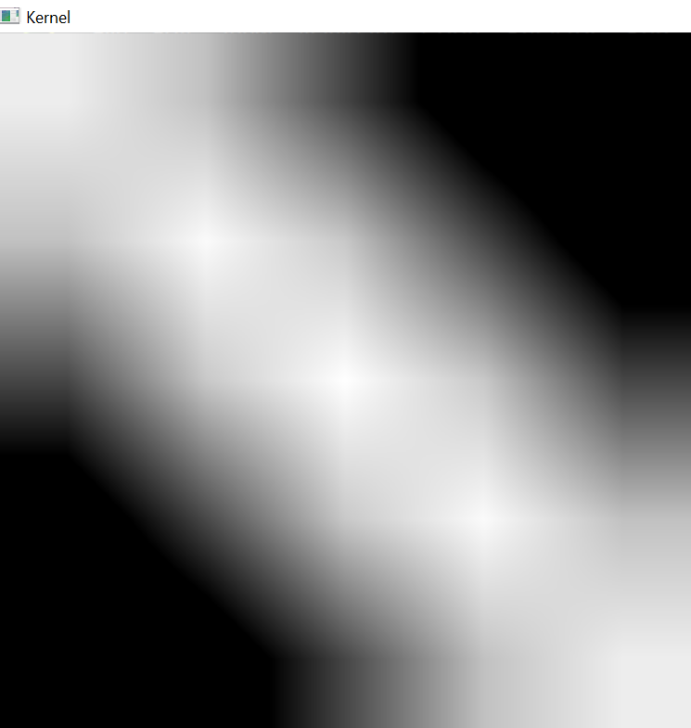

Gabor filters

Slide 13
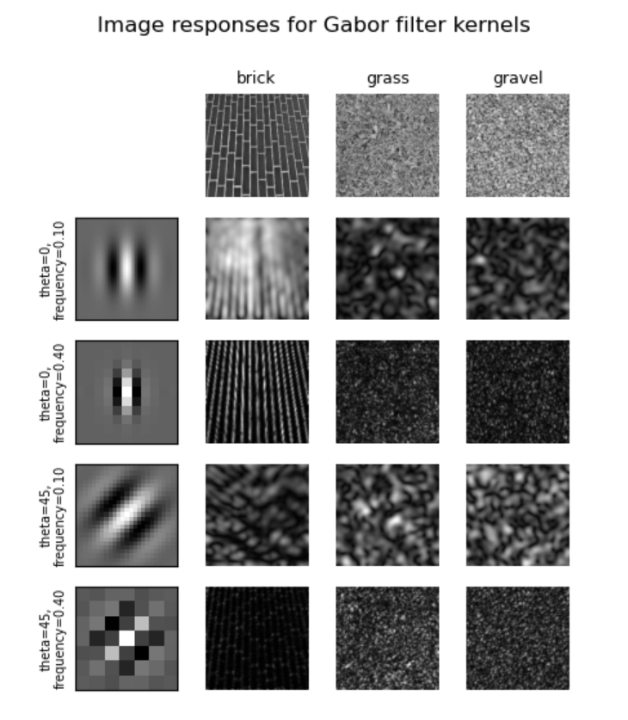
Conclusion and further exploration
Gabor filter banks for texture classification
36.-41. All about Pandas

